Slide 1
MGS 723: Geodynamics
Class 13: Finite Differences
Content mainly sourced from Becker and Kaus, Numerical Geodynamics

Slide 2
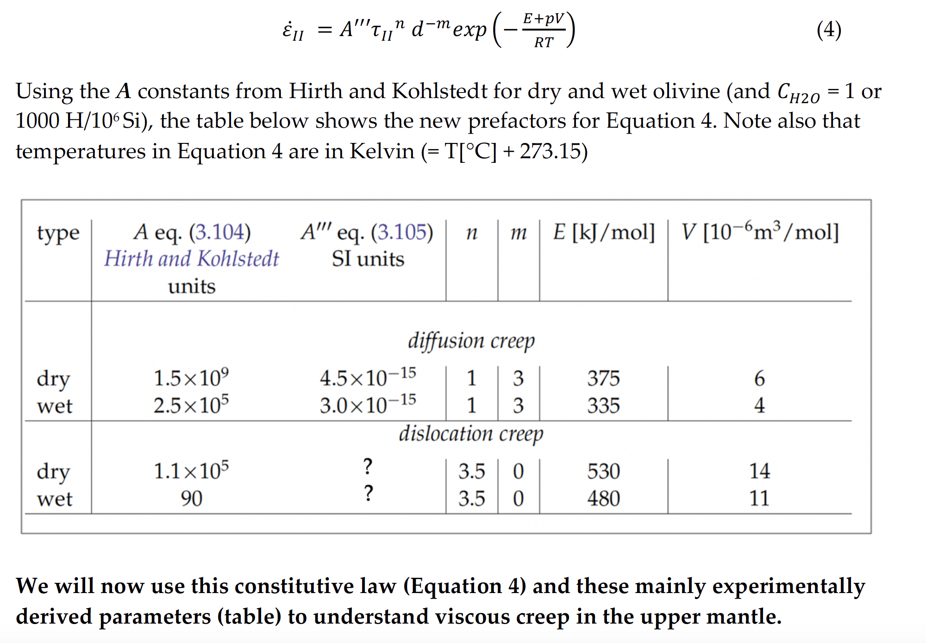
Problem Set #2

Slide 3
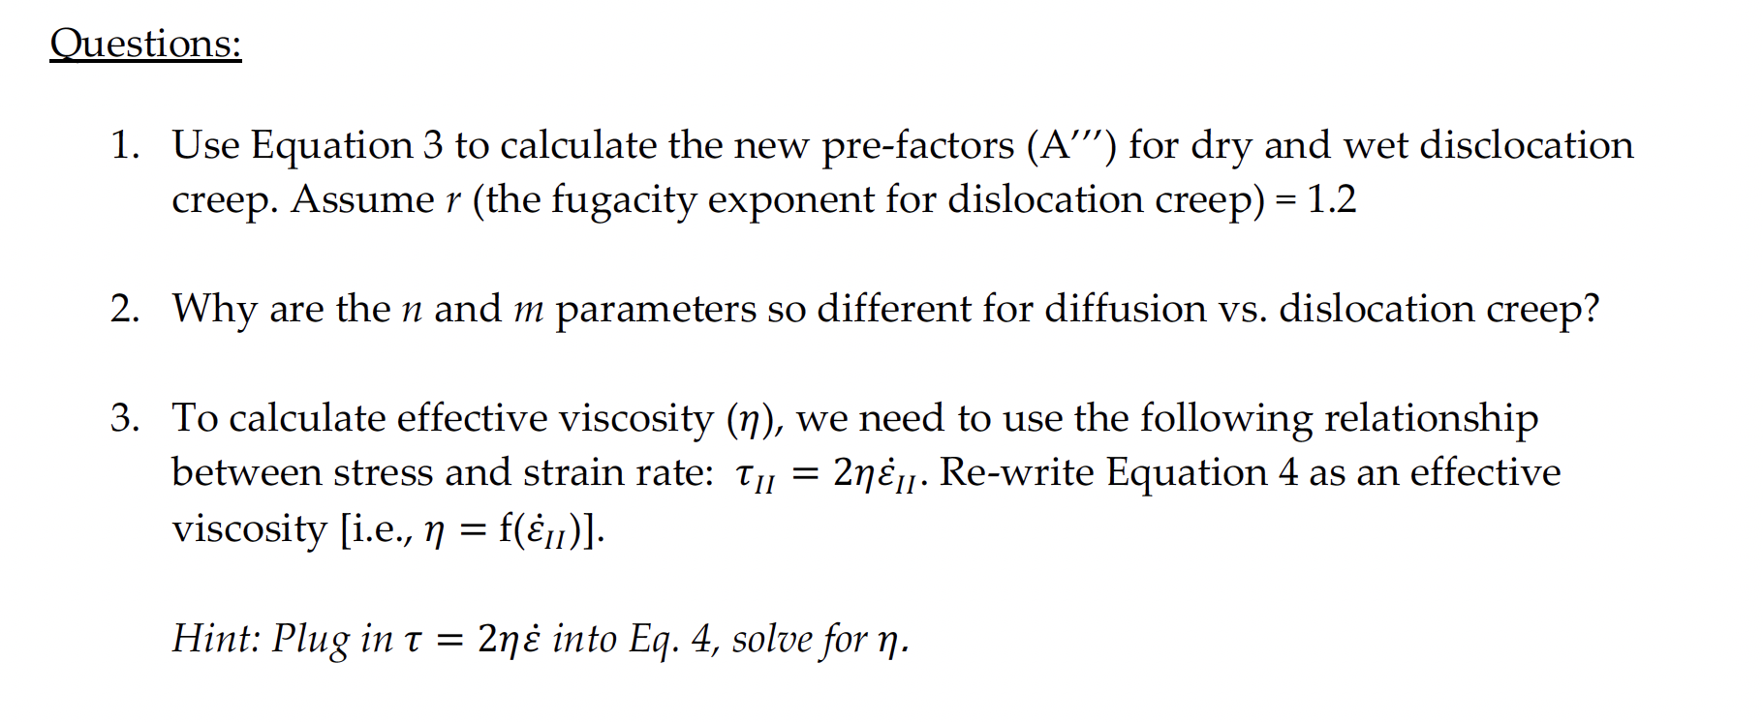
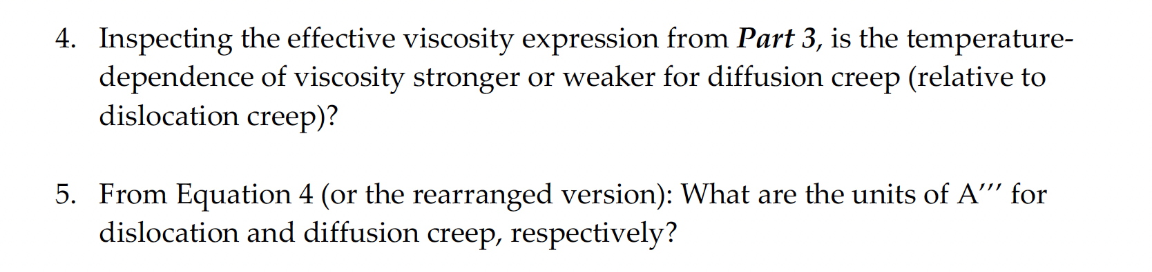
Problem Set #2

Slide 4
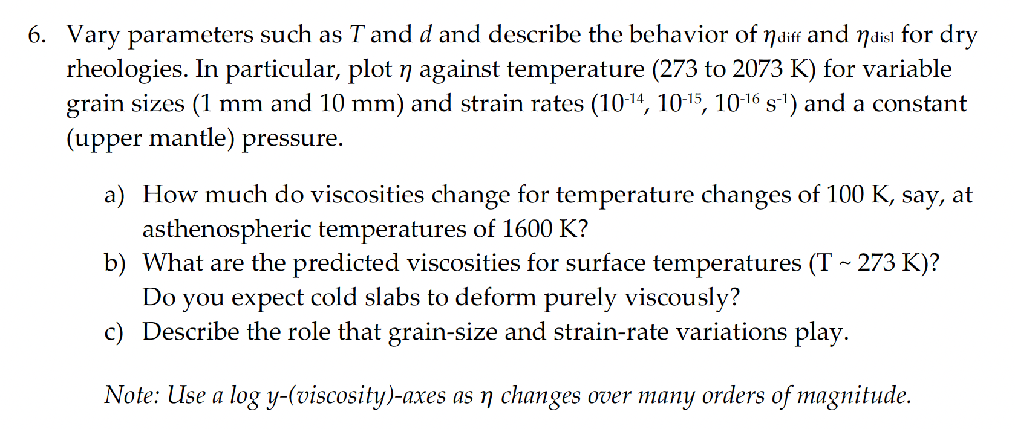
Problem Set #2

Slide 5
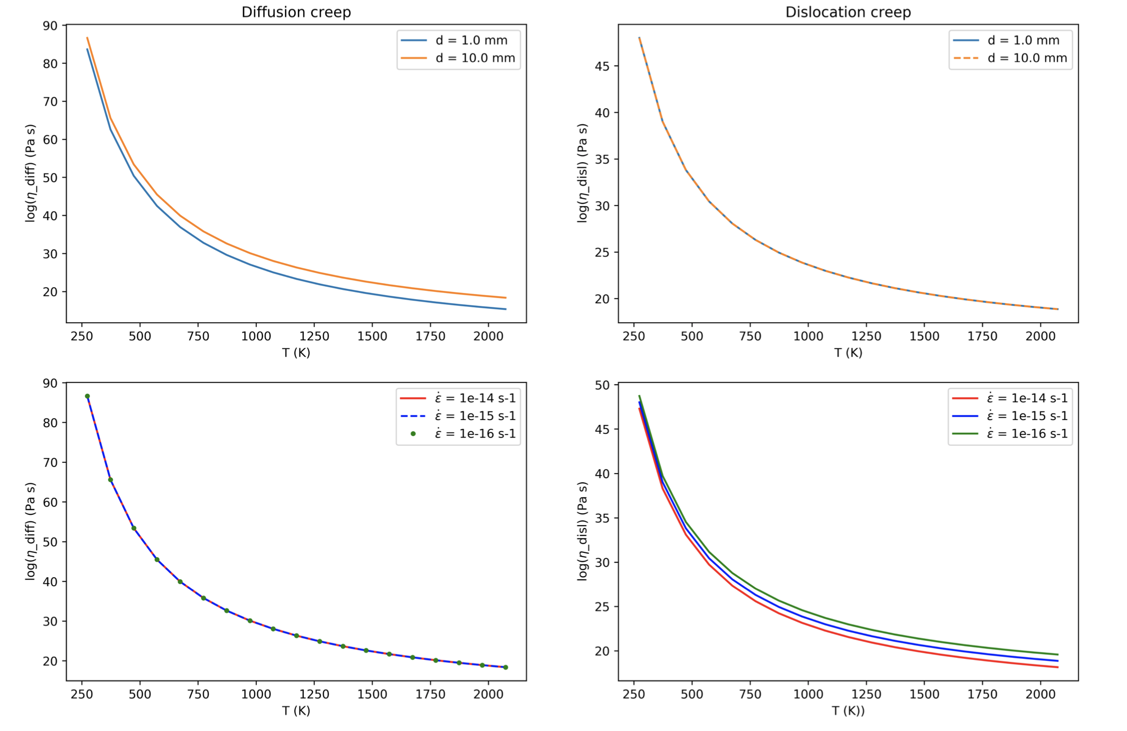
Problem Set #2

Slide 6
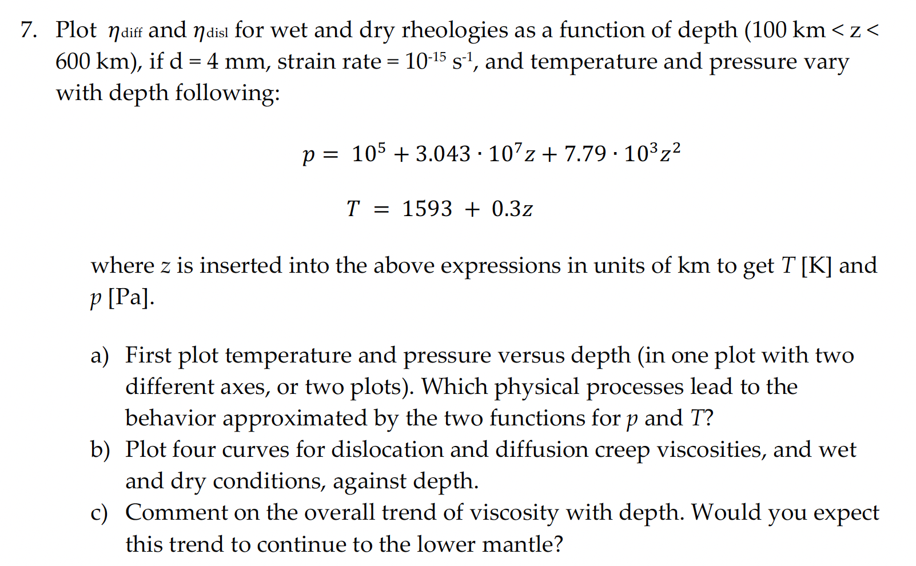
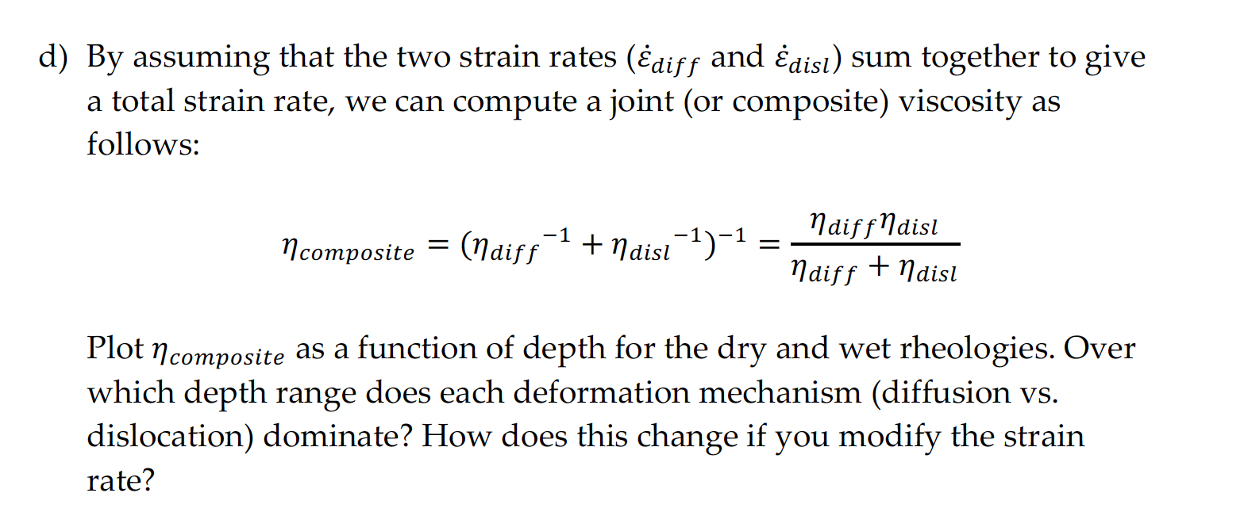
Problem Set #2

Slide 7
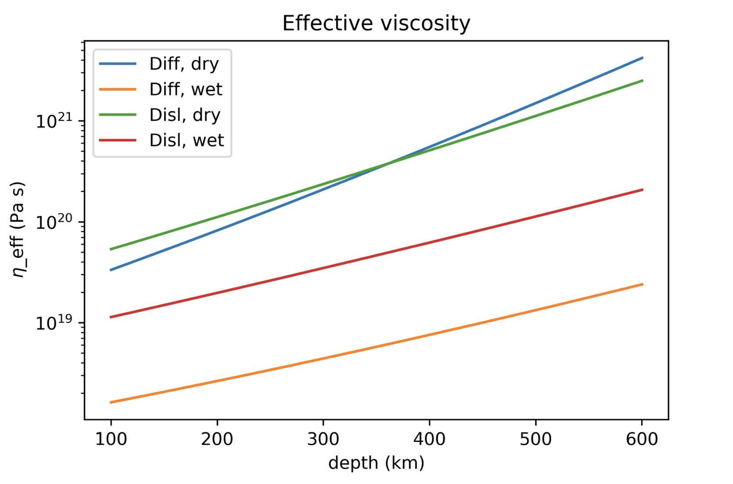
Problem Set #2

Slide 8
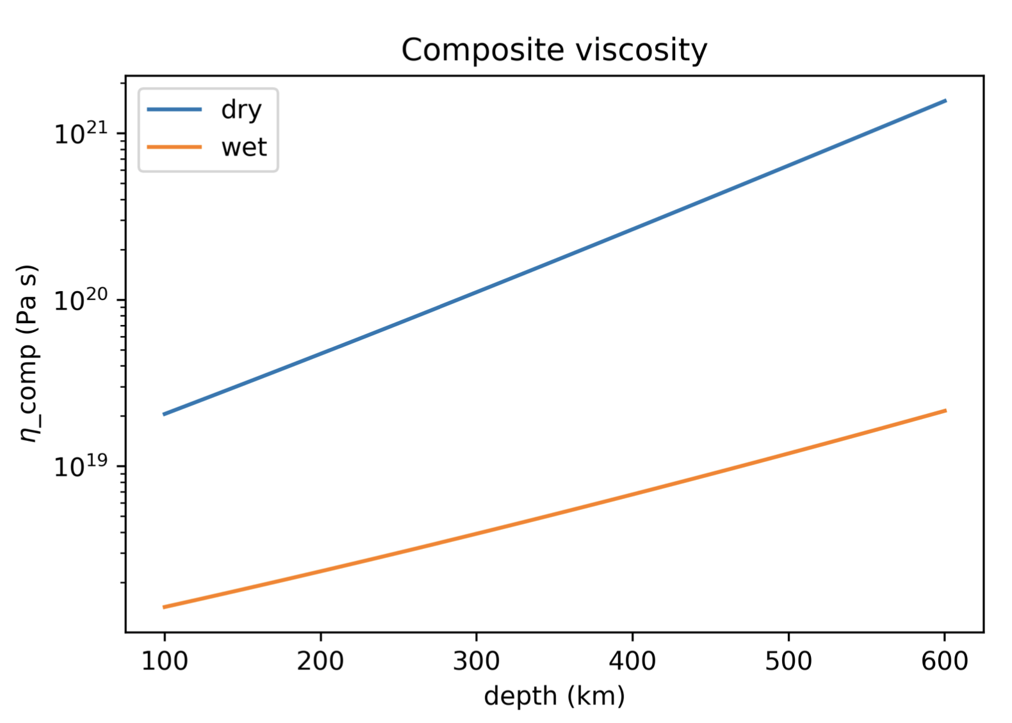
Problem Set #2

Slide 9
Now posted:
Problem set #3
Term paper overview

Slide 10
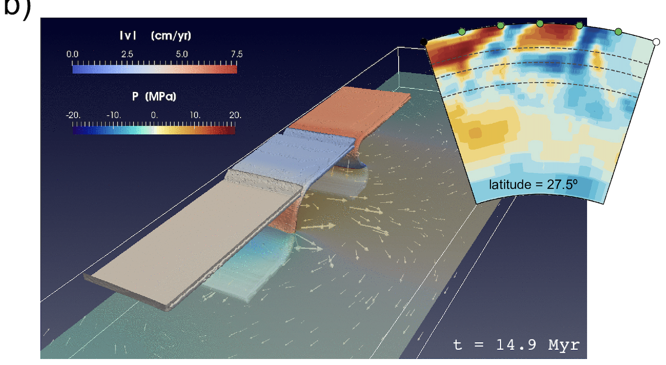
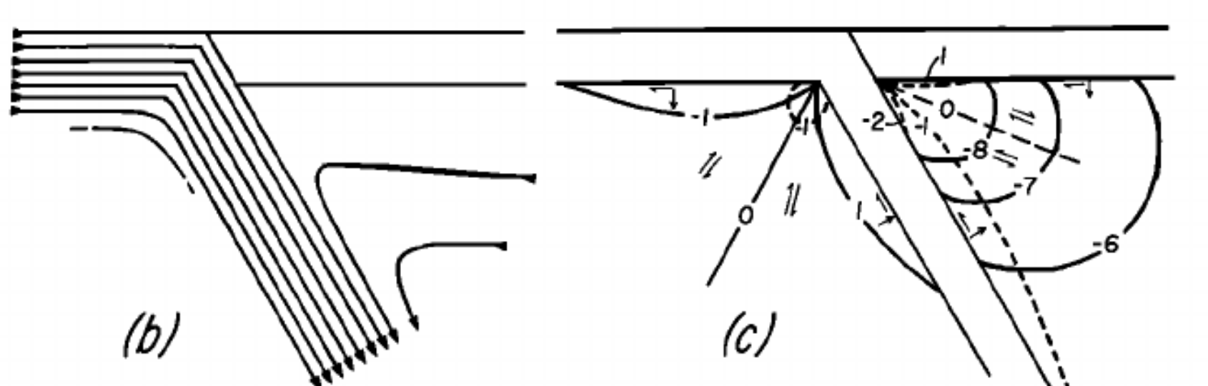
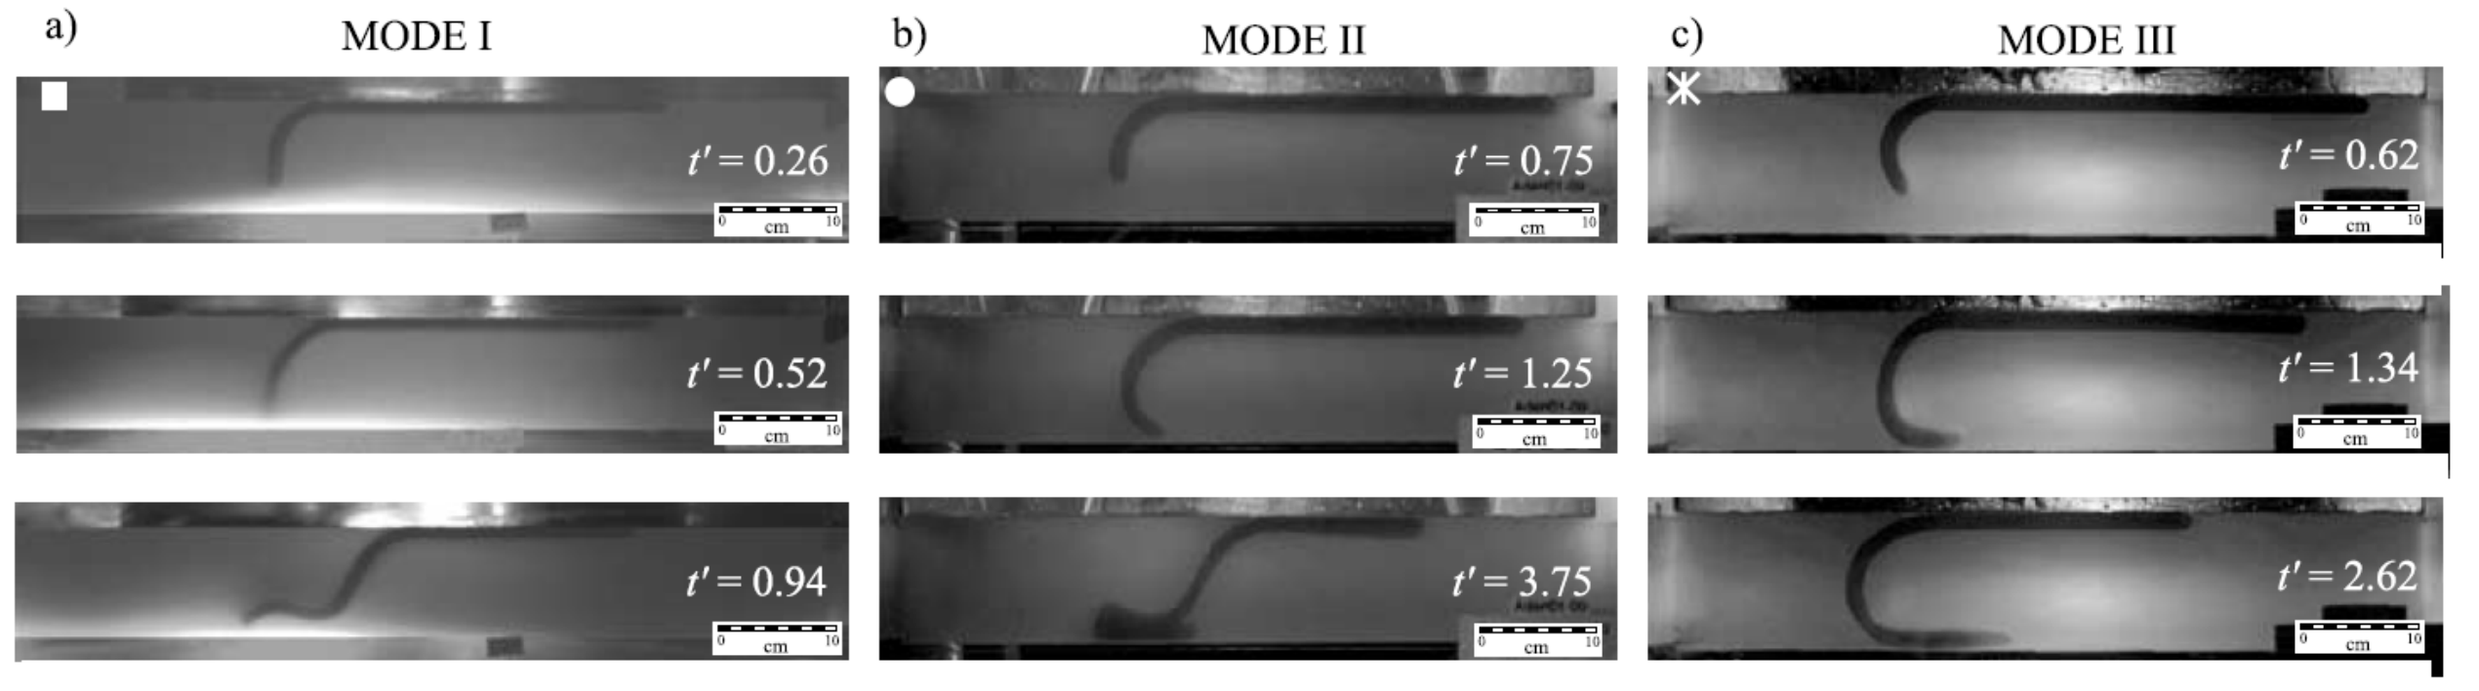
Geodynamic Modeling
Numerical
Analytical
Tovish et al., 1978, JGR
Analog/laboratory
Bellahsen et al., JGR, 2005

Slide 11
Geodynamic Modeling
Numerical
Analytical
Tovish et al., 1978, JGR
Analog/laboratory
Bellahsen et al., JGR, 2005

Slide 12
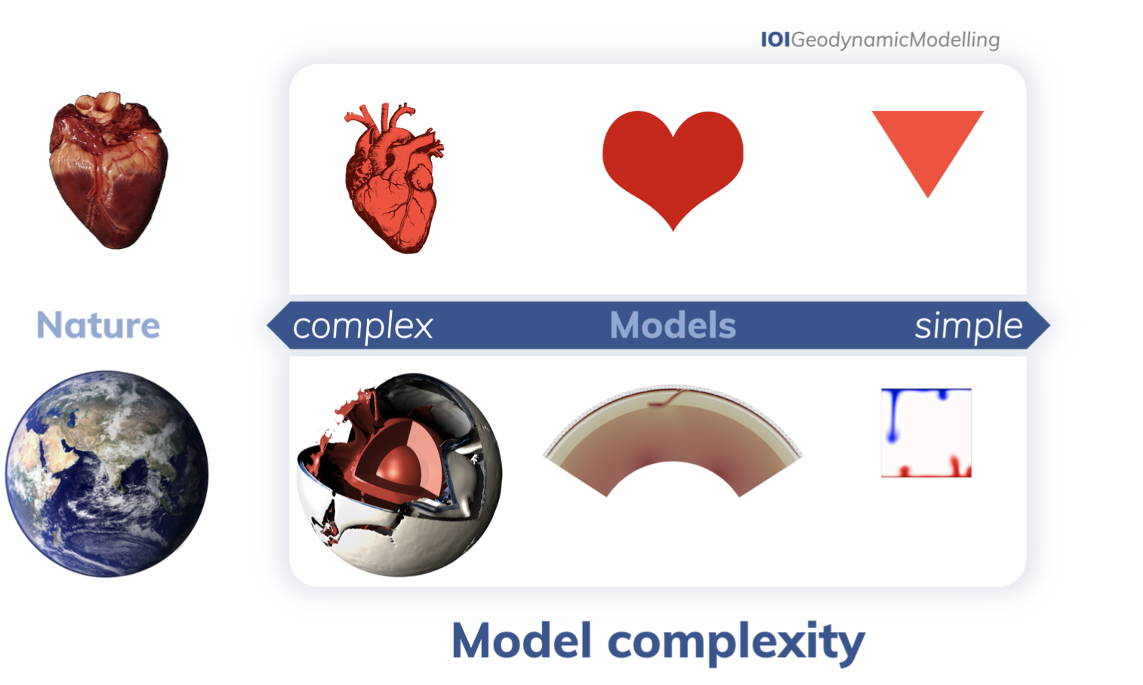
Geodynamic Modeling
Variable complexities:
van Zelst et al., 2021, https://doi.org/10.5194/se-2021-14

Slide 13
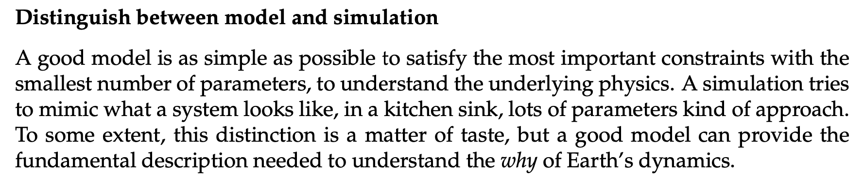
Geodynamic Modeling
Variable complexities:
Becker and Kaus, Numerical geodynamics

Slide 14
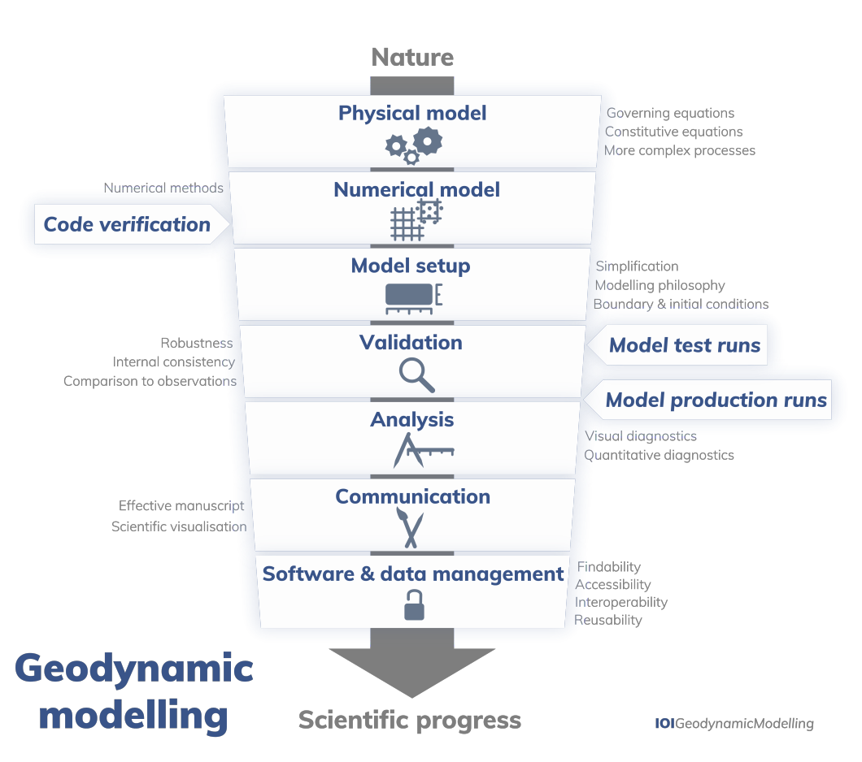
Geodynamic Modeling
The procedure:
van Zelst et al., 2021, https://doi.org/10.5194/se-2021-14

Slide 15
Geodynamic Modeling
The procedure:
Today:
Physical model
Numerical model
Model setup
van Zelst et al., 2021, https://doi.org/10.5194/se-2021-14

Slide 16
Geodynamic Modeling
The procedure:
Today:
Physical model
Numerical model
Model setup
van Zelst et al., 2021, https://doi.org/10.5194/se-2021-14

Slide 17
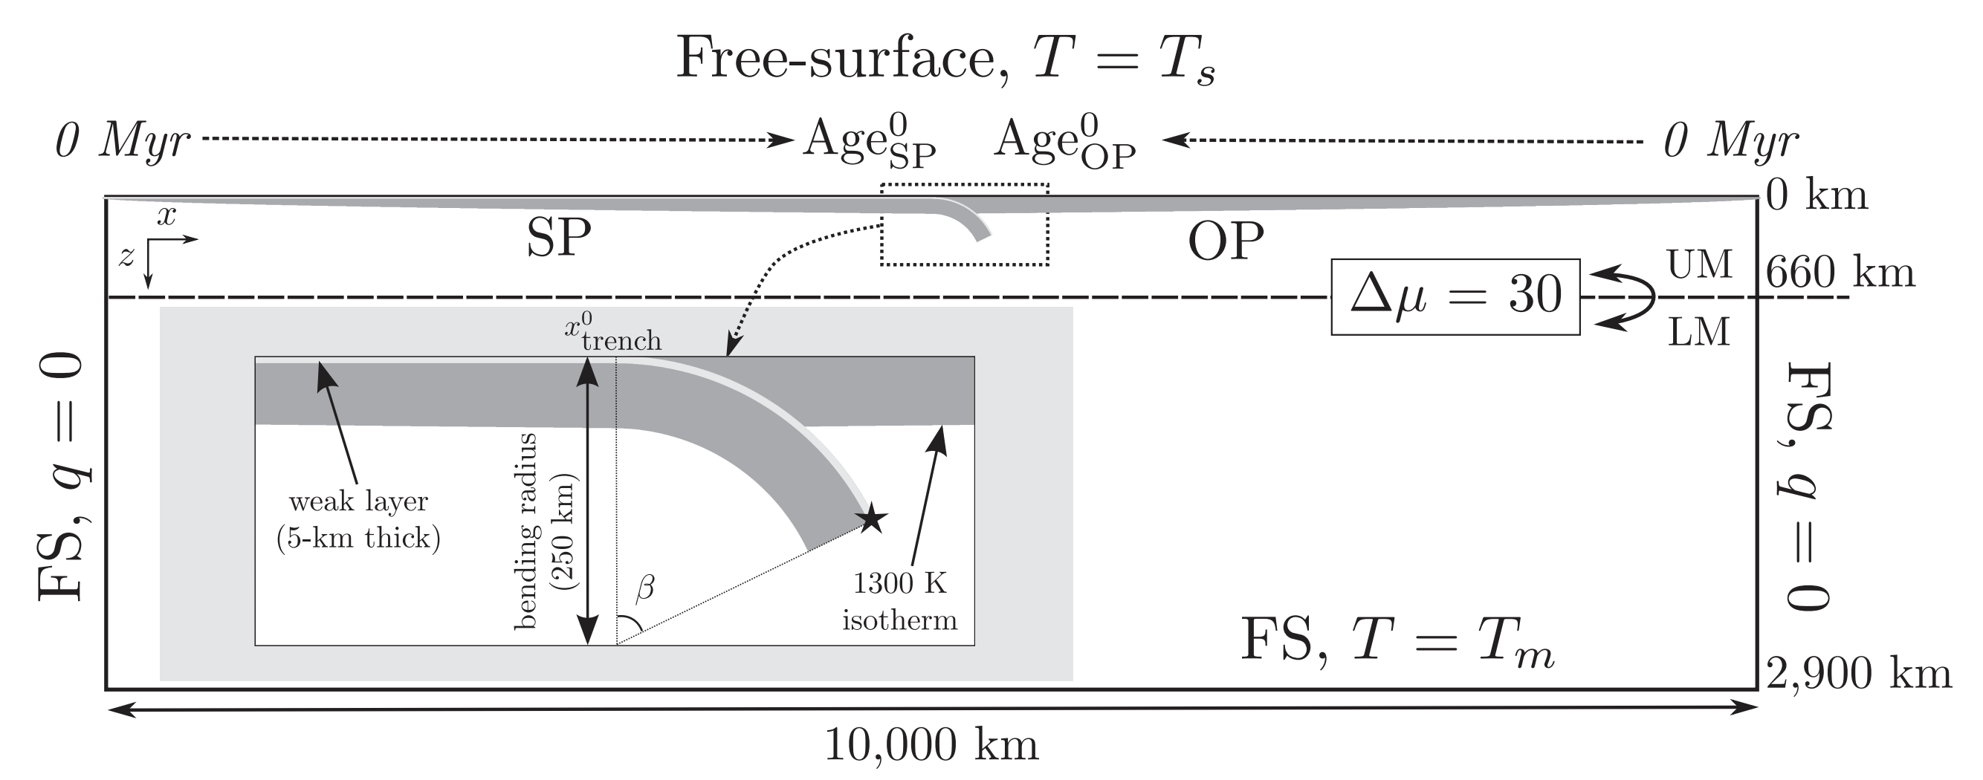
An example Physical Model and Model Setup
Model setup (e.g., domain size, BCs, initial geometry)

Slide 18
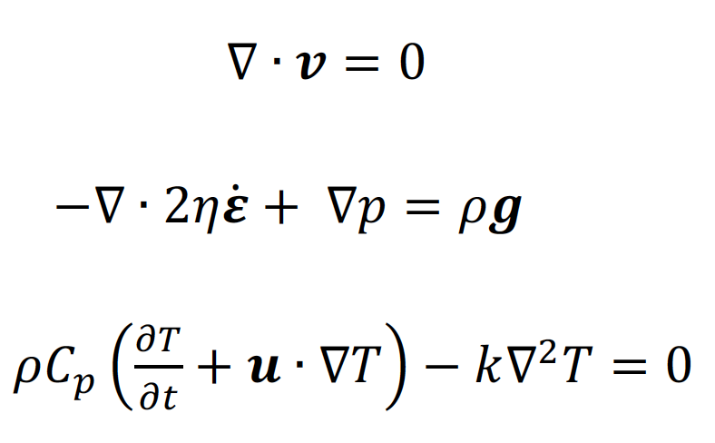
An example Physical Model and Model Setup
Model setup (e.g., domain size, BCs, initial geometry)
Physical model (What’s the physics? What equations do we solve?)
Conservation of mass
Conservation of momentum
Conservation of energy

Slide 19
Geodynamic Modeling
The procedure:
Today:
Physical model
Numerical model
Model setup
van Zelst et al., 2021, https://doi.org/10.5194/se-2021-14

Slide 20
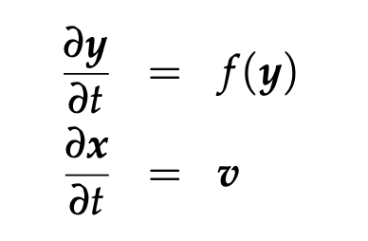
Main types of equations in Geodynamics:
Ordinary differential equations (ODEs), e.g.:
(one independent variable)
1st order ODEs

Slide 21
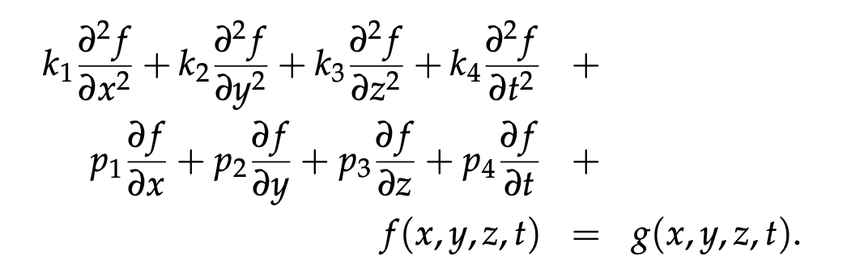
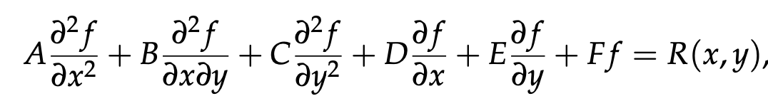
Main types of equations in Geodynamics:
Ordinary differential equations (ODEs), e.g.:
(one independent variable)
1st order ODEs
Partial differential equations (PDEs):
(>1 independent variable)
2nd order PDE
2nd order PDE as function of two variables

Slide 22
Main types of equations in Geodynamics:
2nd order PDE as function of two variables

Slide 23
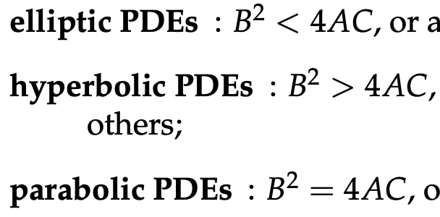
Main types of equations in Geodynamics:
2nd order PDE as function of two variables
A classification system for 2nd order PDEs:
Helps us to determine:
i) a solution strategy,
ii) which boundary and initial conditions are needed:

Slide 24
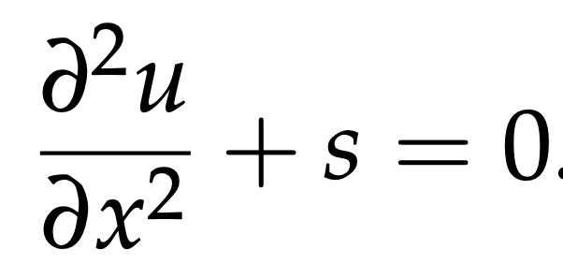
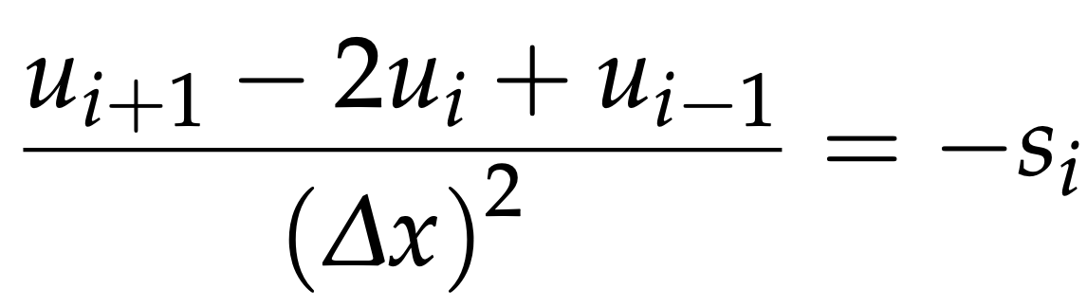
Two main numerical solution methods
Finite differences
Finite elements
Approximates derivatives by Taylor series. Combine approximated derivatives to solve full equation on a grid, e.g.:
Pros: conceptually simple, approximates the PDE
Cons: bad for sharp contrasts in properties, bad for complex model geometries.

Slide 25
Two main numerical solution methods
Finite differences
Finite elements
Approximates derivatives by Taylor series. Combine approximated derivatives to solve full equation on a grid, e.g.:
Pros: conceptually simple, approximates the PDE
Cons: bad for sharp contrasts in properties, bad for complex model geometries.
Approximates the PDE solution (instead of the PDE) using integrals.
Examples in
subsequent classes…
Pros: good for sharp contrasts in properties and complex model geometries, allow mesh refinement
Cons: conceptually trickier, need to carefully choose type of elements, integration methods, etc. etc.

Slide 26
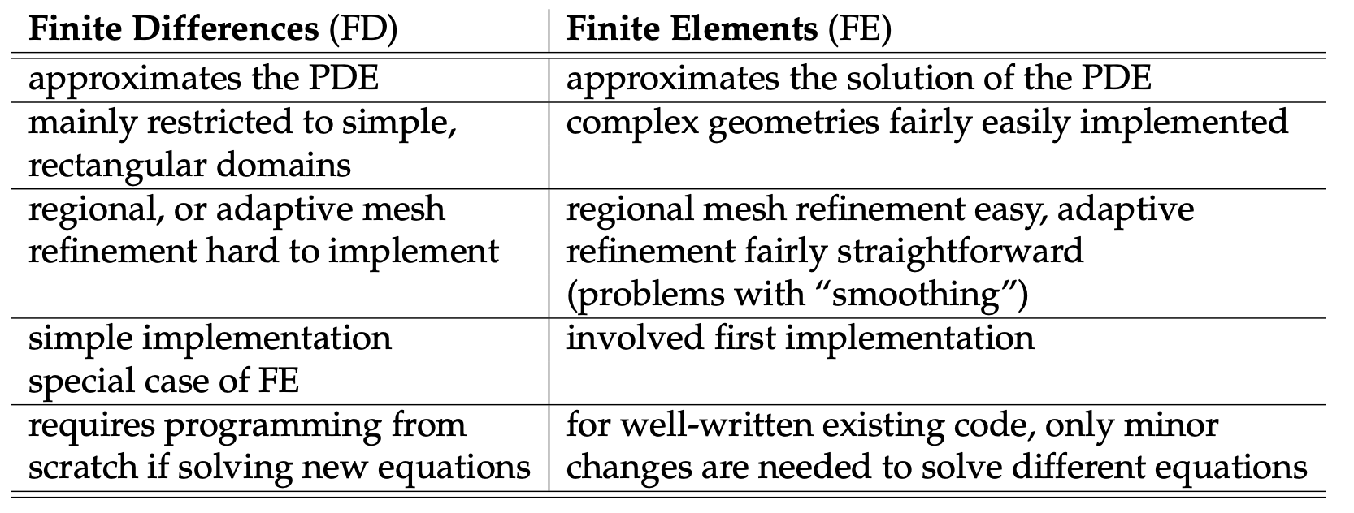
Two main numerical solution methods
Becker and Kaus, Numerical geodynamics

Slide 27
Two main numerical solution methods
Becker and Kaus, Numerical geodynamics
Note: Also, Finite Volume (FV) method (not widespread in geodynamics)
A great FV YouTube explainer: https://www.youtube.com/watch?v=E9_kyXjtRHc

Slide 28
Two main numerical solution methods
Becker and Kaus, Numerical geodynamics
Note: Also, Finite Volume method (not widespread in geodynamics)

Slide 29
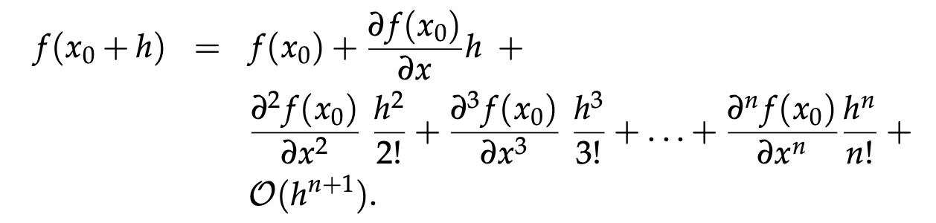
The Finite Difference method
Based on Taylor series expansions:
Becker and Kaus, Numerical geodynamics

Slide 30
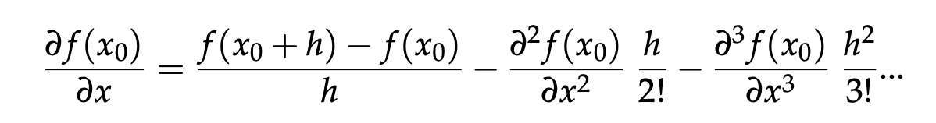
The Finite Difference method
Based on Taylor series expansions:
Can rearrange to get the first derivative:
Becker and Kaus, Numerical geodynamics

Slide 31
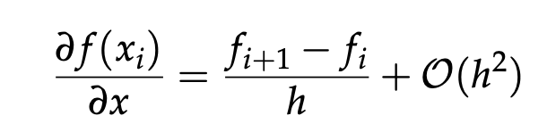
The Finite Difference method
Based on Taylor series expansions:
Can rearrange to get the first derivative:
If we ignore 2nd order terms, and discretize on a grid:
h
f_{i}
f_{i+1}
y
i-2
i-1
i
i+1
i+2
x
Becker and Kaus, Numerical geodynamics

Slide 32
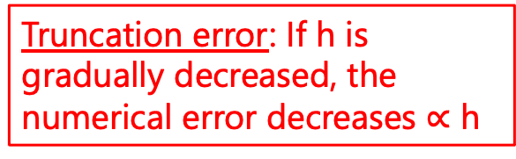
The Finite Difference method
Based on Taylor series expansions:
Can rearrange to get the first derivative:
If we ignore 2nd order terms, and discretize on a grid:
h
f_{i}
f_{i+1}
Truncation error: If h is gradually decreased, the numerical error decreases $∝$ h
y
i-2
i-1
i
i+1
i+2
x
Becker and Kaus, Numerical geodynamics

Slide 33
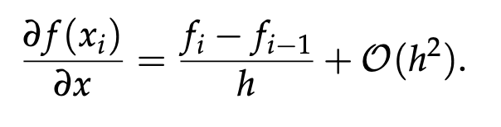
The Finite Difference method
Based on Taylor series expansions:
Can rearrange to get the first derivative:
If we ignore 2nd order terms, and discretize on a grid:
h
f_{i-1}
f_{i}
Also: Backwards derivative:
y
i-2
i-1
i
i+1
i+2
x
Becker and Kaus, Numerical geodynamics

Slide 34
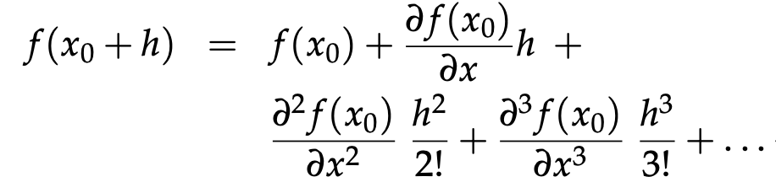
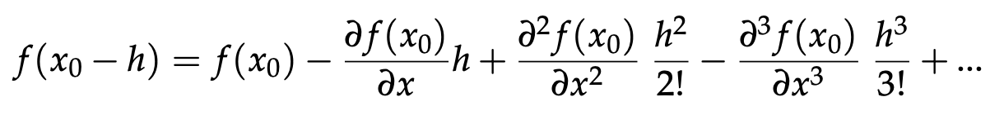
Second derivative?
Forwards Taylor expansion:
Backwards Taylor expansion:

Slide 35
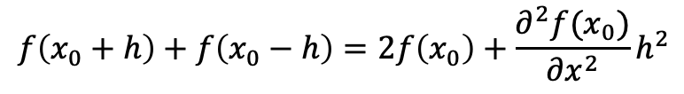
Second derivative?
Forwards Taylor expansion:
Backwards Taylor expansion:
Summing the above two expressions:
$$f\left(x_{0}+h\right)+f\left(x_{0}−h\right)=2f\left(x_{0}\right)+\frac{∂^{2}f(x_{0})}{∂x^{2}}h^{2}$$

Slide 36
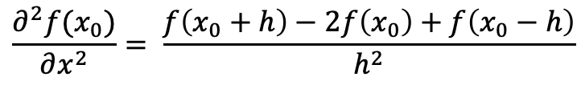
Second derivative?
Forwards Taylor expansion:
Backwards Taylor expansion:
Summing the above two expressions:
$$f\left(x_{0}+h\right)+f\left(x_{0}−h\right)=2f\left(x_{0}\right)+\frac{∂^{2}f(x_{0})}{∂x^{2}}h^{2}$$
$$\frac{∂^{2}f(x_{0})}{∂x^{2}}= \frac{f\left(x_{0}+h\right)−2f\left(x_{0}\right)+f\left(x_{0}−h\right)}{h^{2}}$$

Slide 37
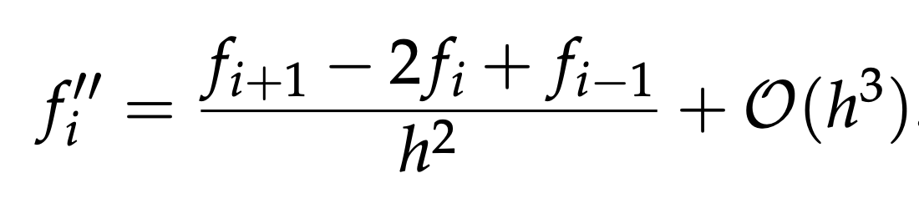

Second derivative?
Forwards Taylor expansion:
Backwards Taylor expansion:
Summing the above two expressions:
$$f\left(x_{0}+h\right)+f\left(x_{0}−h\right)=2f\left(x_{0}\right)+\frac{∂^{2}f(x_{0})}{∂x^{2}}h^{2}$$
h
$$\frac{∂^{2}f(x_{0})}{∂x^{2}}= \frac{f\left(x_{0}+h\right)−2f\left(x_{0}\right)+f\left(x_{0}−h\right)}{h^{2}}$$
f_{i-1}
f_{i}
f_{i+1}
$$2$$
y
i-2
i-1
i
i+1
i+2
x

Slide 38
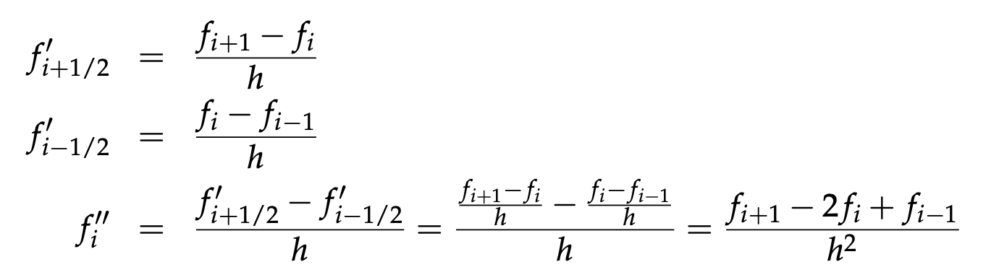
Second derivative?
Can also derive as follows (by combining a forward and backward first derivative):
h
f_{i-1}
f_{i}
f_{i+1}
$$2$$
i-2
i-1
i
i+1
i+2

Slide 39
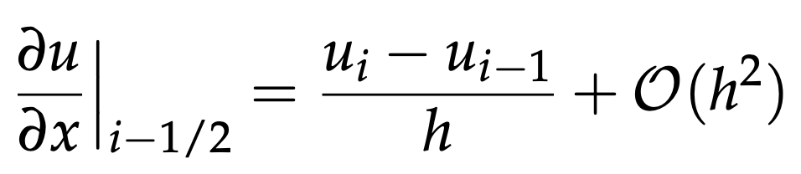
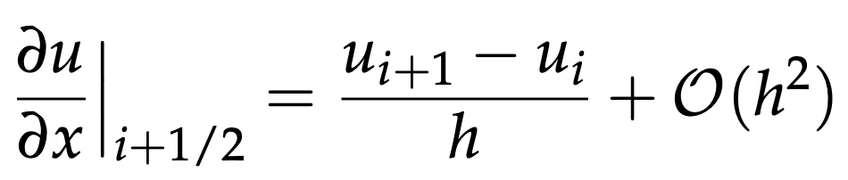
First derivatives with difference accuracies:
Left-sided (first order accurate):
Right-sided (first order):

Slide 40
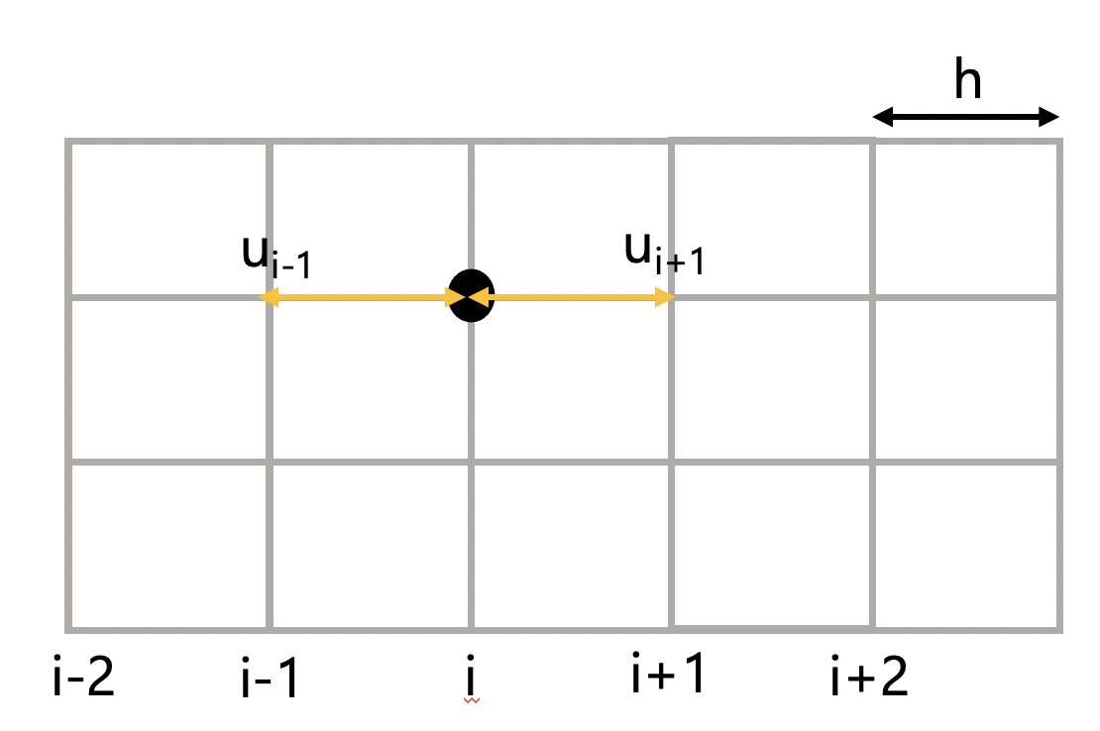
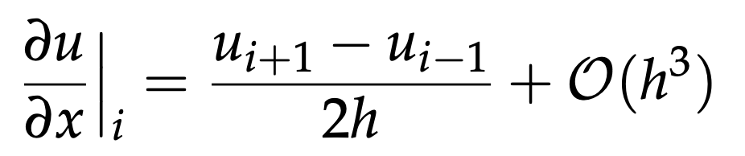
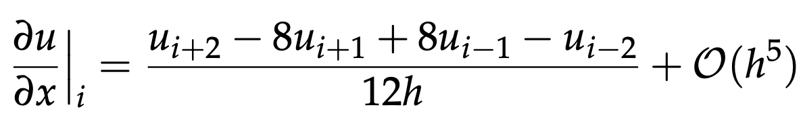


First derivatives with difference accuracies:
Left-sided (first order accurate):
Right-sided (first order):
Central (second order):
$$2$$
Central (fourth order):
h
$$4$$
u_{i-2}
u_{i-1}
u_{i+1}
u_{i+2}
i-2
i-1
i
i+1
i+2

Slide 41
First derivatives with difference accuracies:
Left-sided (first order accurate):
Right-sided (first order):
Central (second order):
$$2$$
Central (fourth order):
h
$$4$$
u_{i-2}
u_{i-1}
u_{i+1}
u_{i+2}
Central differences with second order often a good choice for equations in geodynamics
i-2
i-1
i
i+1
i+2

Slide 42
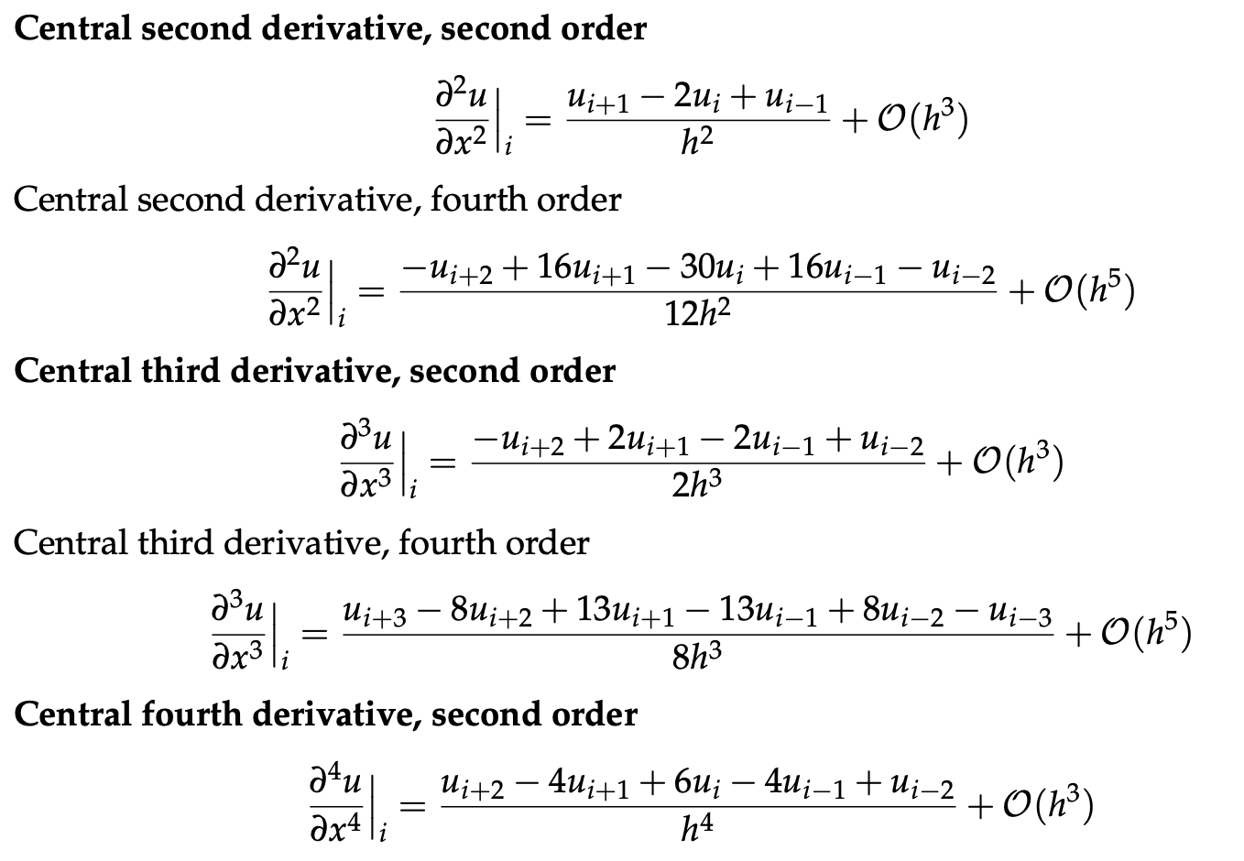





Second and third derivatives with difference accuracies:
$$2$$
$$4$$
$$2$$
$$4$$
$$2$$
Becker and Kaus, Numerical geodynamics

Slide 43
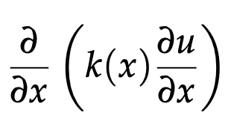
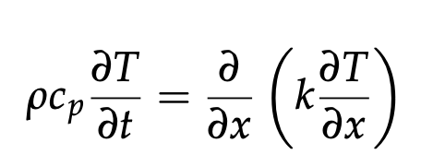
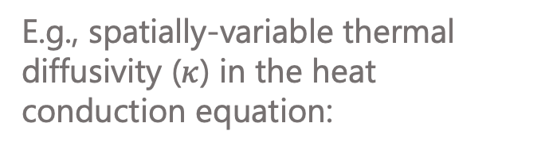
Finite differences with variable coefficients
E.g., spatially-variable thermal diffusivity ($κ$) in the heat conduction equation:

Slide 44
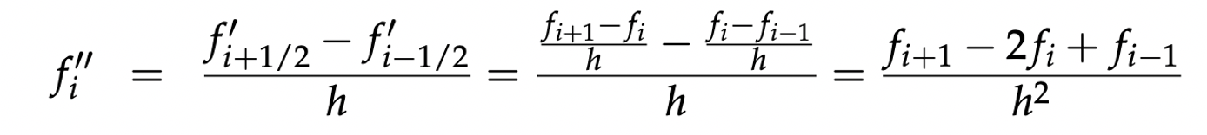
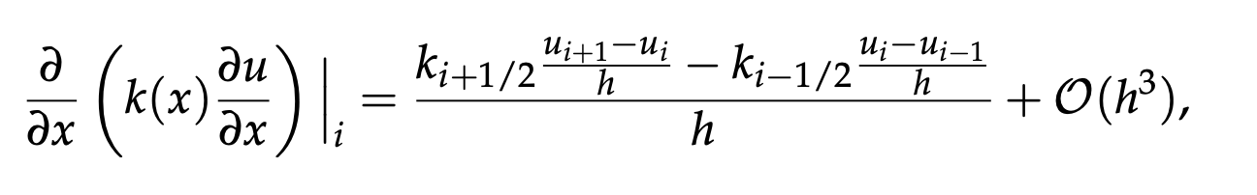
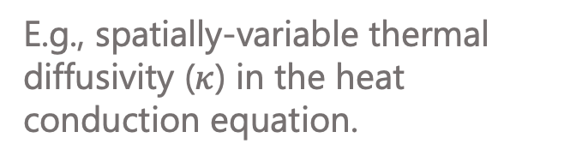

Finite differences with variable coefficients
E.g., spatially-variable thermal diffusivity ($κ$) in the heat conduction equation.
Recall that second derivatives can be approximated as following (to second order):
The second derivative with variable k can be written as following (to second order):
$$2$$

Slide 45

Finite differences with variable coefficients
The second derivative with variable k can be written as following (to second order):
$$2$$

Slide 46

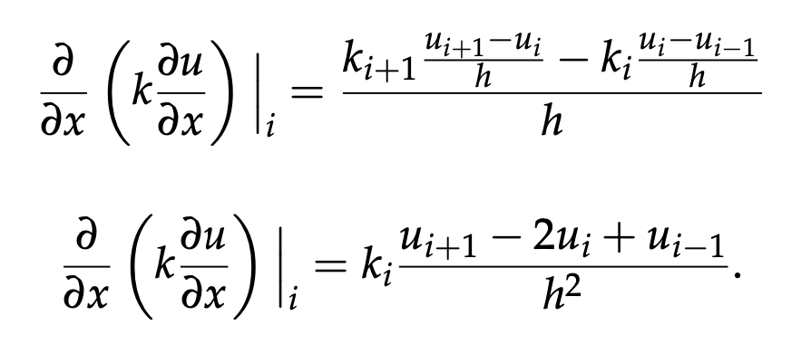

Finite differences with variable coefficients
The second derivative with variable k can be written as following (to second order):
$$2$$
Note that the following expressions do not retain second order accuracy (i.e., avoid using):
(This is due to how k is approximated over the spatial range of the second derivative)

Slide 47
Next class:
Using FD to solve heat flow problems!

Slide 48
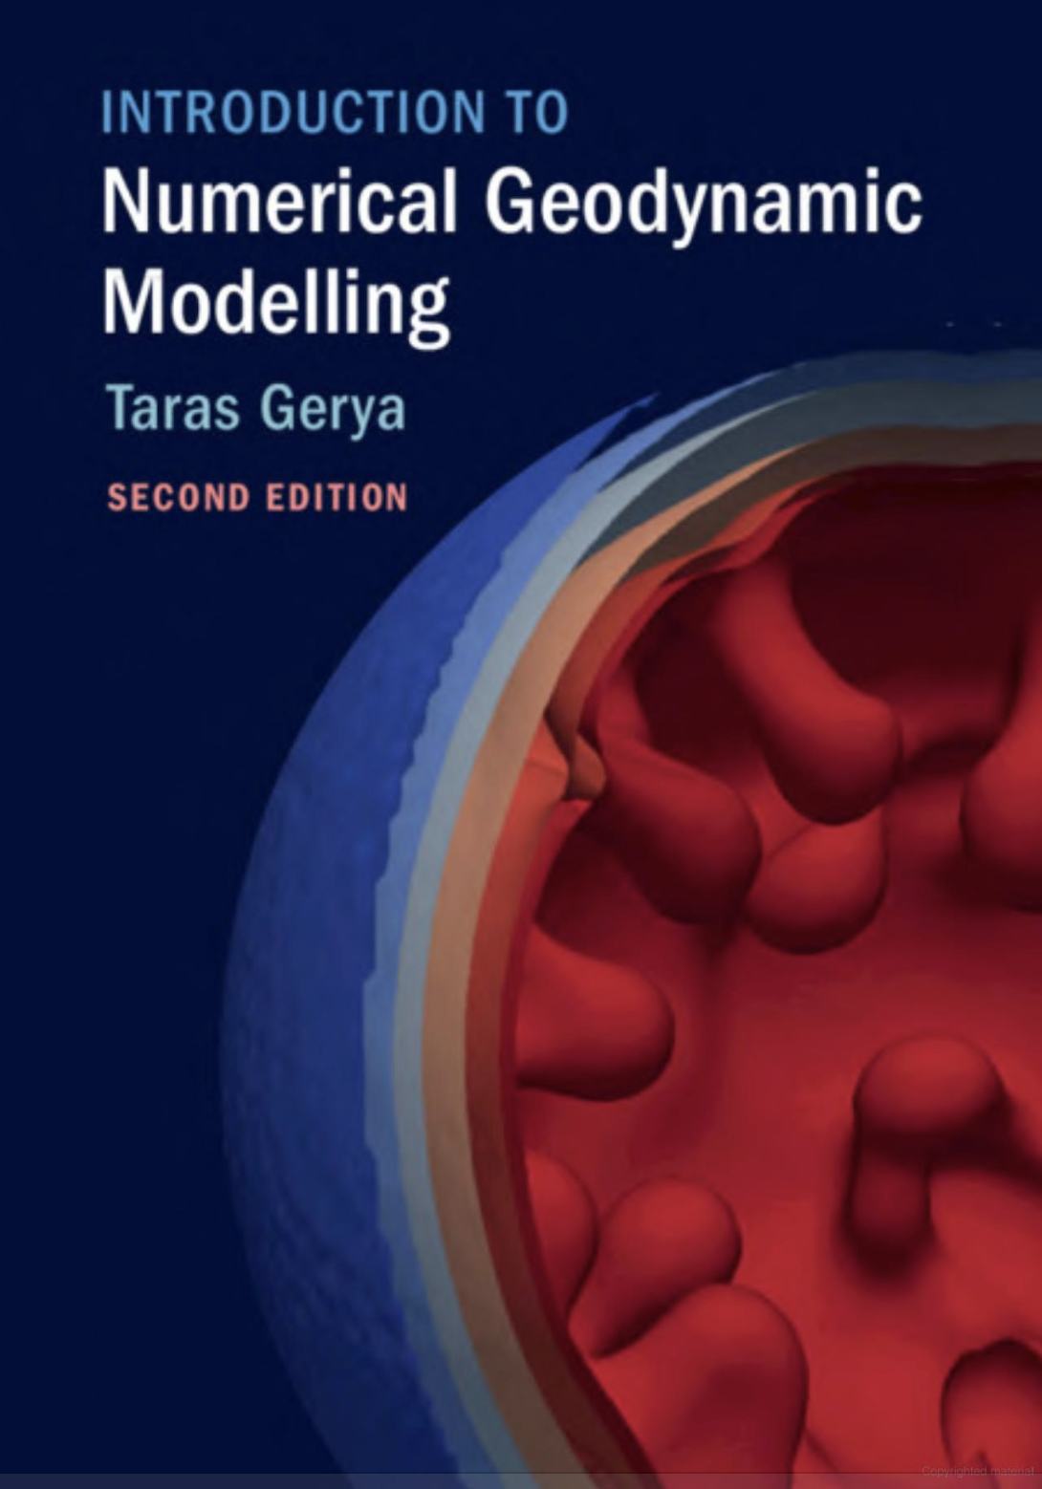
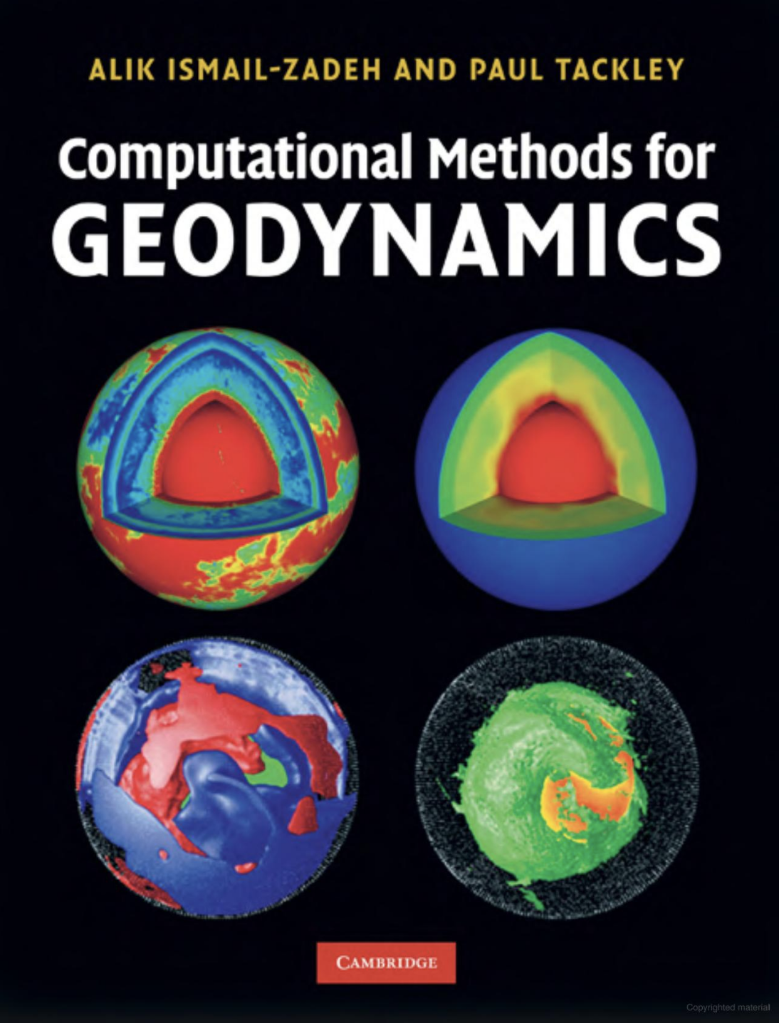



Numerical geodynamics resources
Finite difference method
Modeling overview
Modeling overview and example code
http://www-udc.ig.utexas.edu/external/becker/Geodynamics557.pdf

Slide 49
Take homes:
Finite Difference and Finite Elements the dominant numerical methods to solve PDEs in geodynamics.
Finite Differences works by using Taylor Series to discretize differentials (i.e., split them up into values at individual grid points).
Each discretization is associated with a truncation error which scales with the grid spacing to some power (the higher the power, the better!).
Need to be careful with spatially variable coefficients (e.g., conductivity in the heat equation).

